Slide 1
Moving to Dubai
Ahmed Nady
28th of April 2020

Slide 2
Introduction
Dubai is a Multicultural city with different Nationalities
Movement from your home City to Dubai is a very big challenge
Need to search about a specific place that matches your requirements for satisfactions
We need to find
1- which neighborhoods the most interesting venues to us
2- which place have a good density of population not high neither low density

Slide 3
Data Acquisition and cleaning
Data Acquisition:
1-Extracting Dubai Neighborhoods list with the area and population per each neighborhood here on Wikipedia,
2-Extract venues per each neighborhood from Foursquare Places API
Data Cleaning:
1-First remove the unneeded columns
2- we found sub-neighborhoods as Neighborhood first,Second ..etc that doesn’t have any information or just a duplicate information from the main Neighborhood so removing those areas and remove duplication from the data frame we had used
3- unifying Numbers as float and remove any characters from it as removing “Km2” from Area and removing “/Km2” from Density then convert it to float to be able to analyze them as numbers
4- Removing missing values as we can’t predict the Area or Density and depend only on complete values set

Slide 4
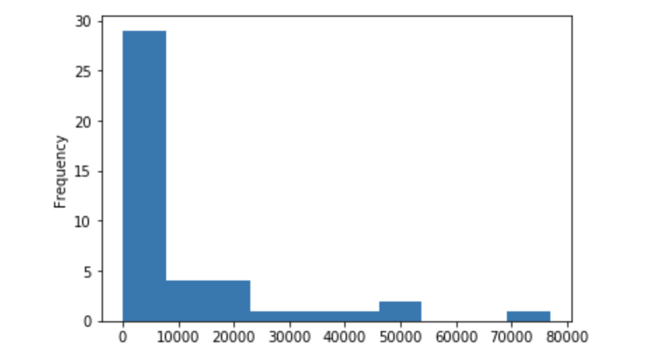
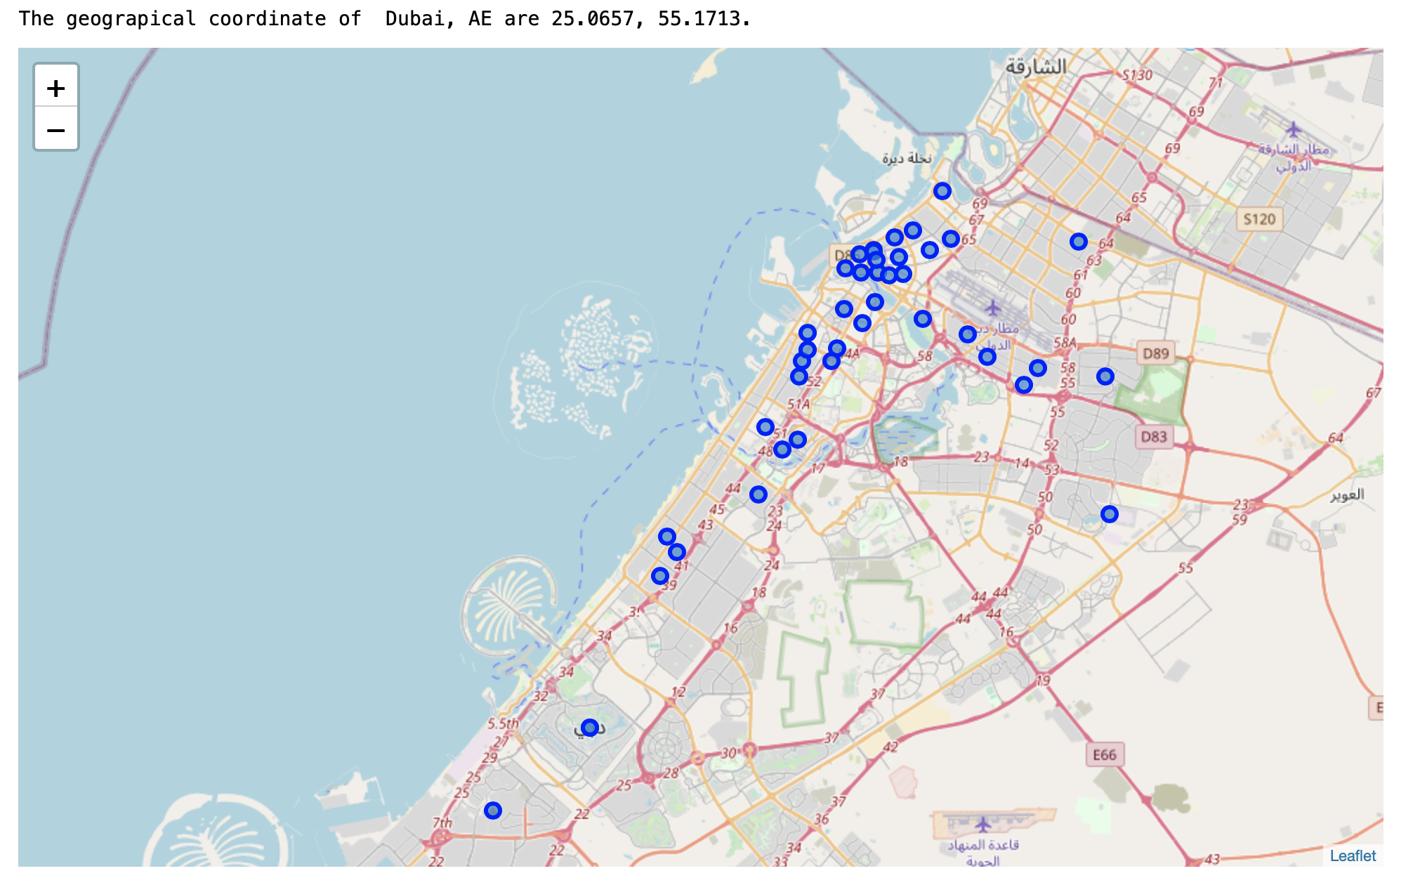
Data Analysis
Density Histgram
Dubai Map
Most Common Venues
Table 1-1
Venue Category | Counts
Hotel | 57
Middle Eastern Restaurant | 45
Café | 41
Asian Restaurant | 34
Coffee Shop | 30
Indian Restaurant | 29
Restaurant | 19
Fast Food Restaurant | 15
Ice Cream Shop | 10
Gym | 10

Slide 5
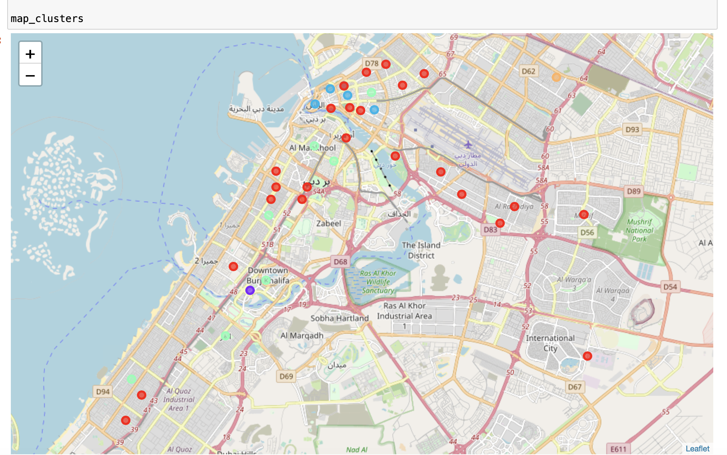
Clustering K-Means
Number of Clusters =5
Cluster 1
it is in Red and representing the most common residential areas , including Parks, Cafes and Restaurants with different Density and Areas
Cluster 2:
it is in Purple and representing Ares with Night life so the theme is hotels, lounges and Nightclubs, and with below avg density
Cluster 3 :
it is in Blue and showing high Density Residential Areas because it is including Restaurants and markets
Cluster 4:
it is in Green and Representing Area for day activities theme , like beach, pool, gym, and restaurants and with different density
Cluster 5:
it is in Orange, and representing Business Area as it has business services, currency exchange centers and an avg density

Slide 6
Conclusion
1- Use this Model to get the best place to reside in within Dubai Neighborhoods
2- Get the best place for your new Business
3- this Model can be enhanced by adding new data sources
a.Price per unit
b. Transportation available in each neighborhood

